Slide 1

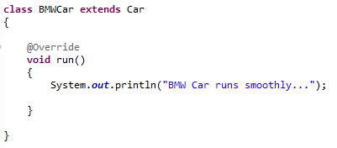
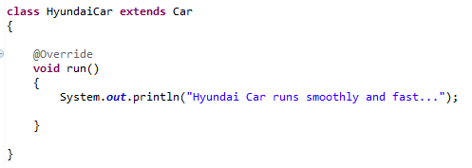
Abstract class in Java
In this example, Car the abstract class that contains only one abstract method run. It implementation is provided by the BMWCar and HyundaiCar classes.
extends
extends

